Slide 1


Basics of Flight Procedure Design
Civil Aviation University of China
Civil Aviation University of China

Slide 2
Learning Objectives
Objective
State the accuracy of NDB, VOR and ILS
List the factors to be considered in the design of flight procedures.
List the categories of aircraft speed.
List the five segments of an approach procedure.
Describe the determination of Decision Altitude.
Describe the determination of Minimum Decision Altitude.
List the types of reversal procedures.
Describe a standard holding pattern
Describe the use of Minimum Sector Altitude.
Identify flight information on a typical departure chart
Identify flight information on a typical SID chart
Identify flight information on a typical Arrival chart
Reference: ICAO Doc 8168

Slide 3

Instrument Flight Procedures

Slide 4
IFR
Instrument Flight Procedure
For: Airways/STARs/Approaches/Departures/SIDs
Which is
Operable for all relevant aircraft
Protected from obstacles and other traffic
Which considers
Aircraft performance
Ground Navigational facilities
Environment (Terrain, communities, etc)

Slide 5
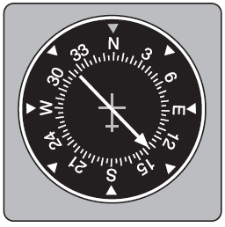
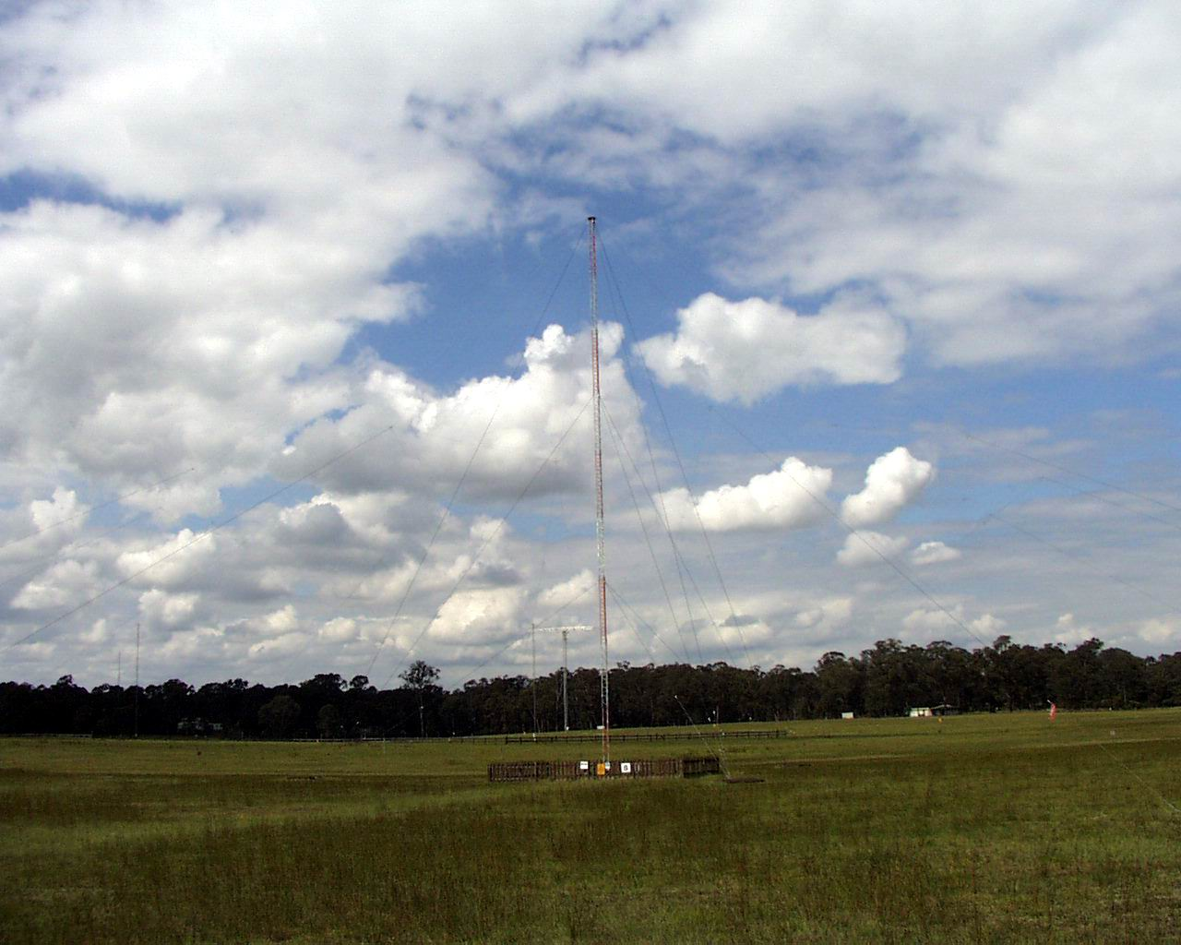
Navigational Aids - NDB

Slide 6
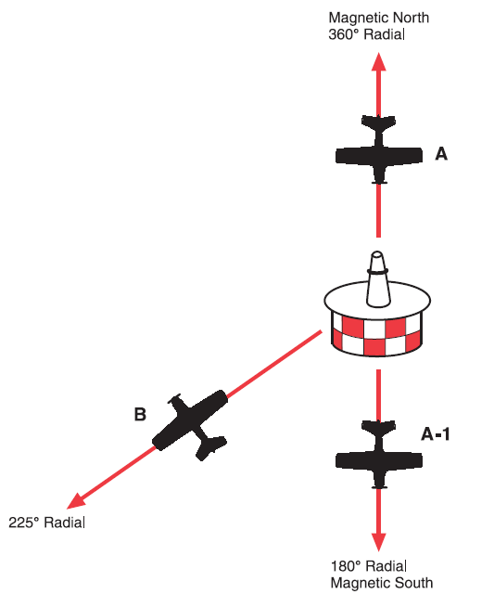

Navigational Aids - VOR

Slide 7
Navigational Aids - VOR

Slide 8
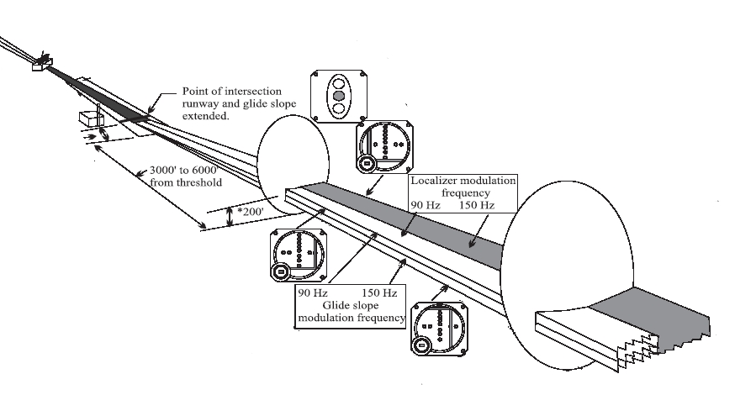
Approach Navigational Aids - ILS

Slide 9
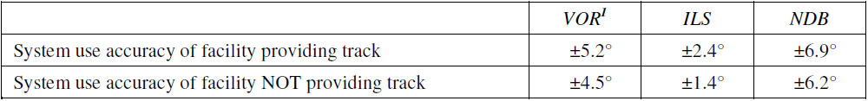
ACCURACY OF TRACK GUIDANCE

Slide 10
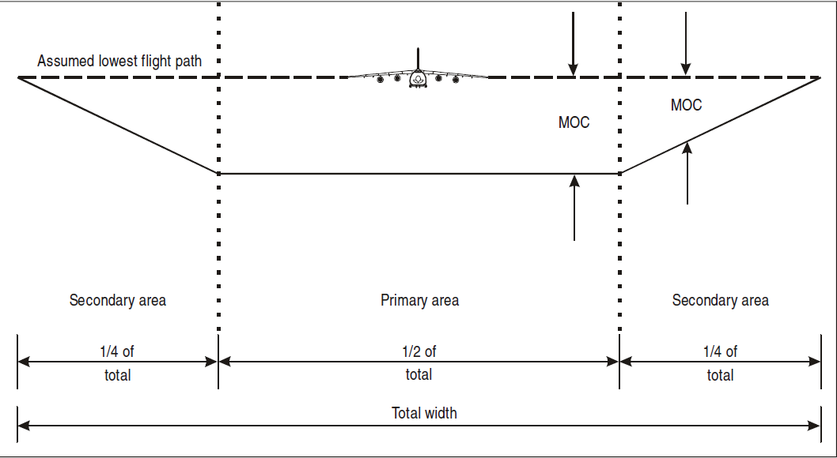
OBSTACLE CLEARANCE
Obstacle clearance is a primary safety consideration

Slide 11
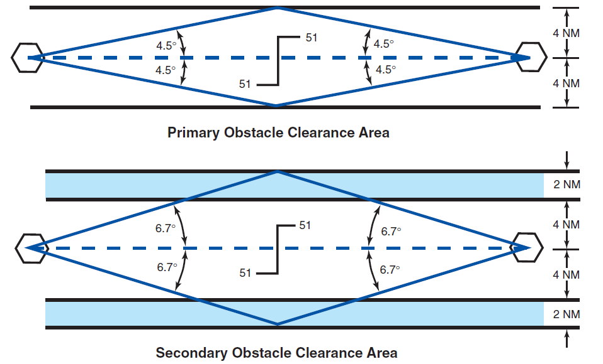
En-route Obstacle Clearance

Slide 12
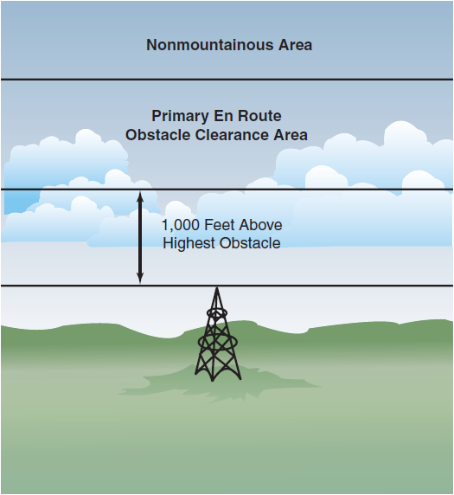
En-route Obstacle Clearance
Obstacle Clearance –Primary Area

Slide 13
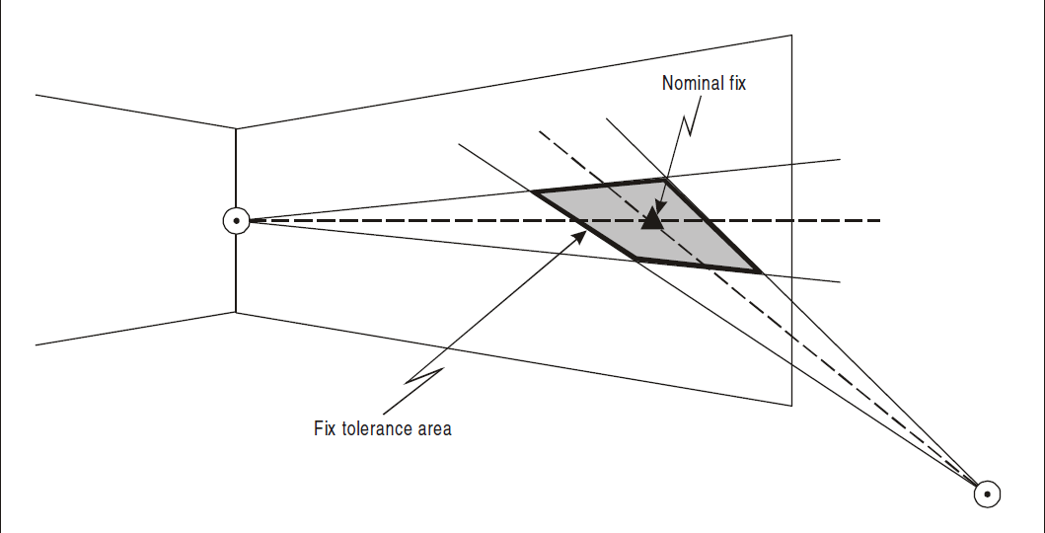
ACCURACY OF FIXES

Slide 14
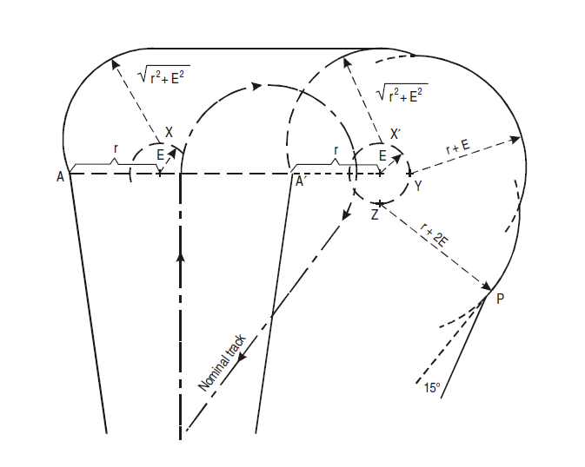
TURN AREA CONSTRUCTION

Slide 15
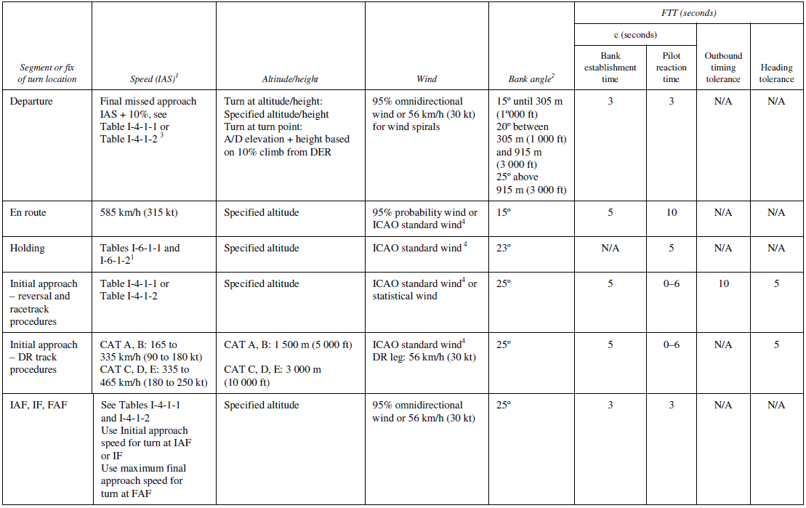
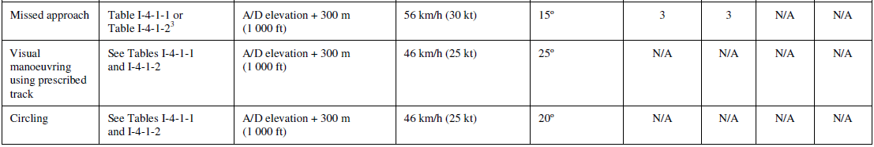
TURN AREA CONSTRUCTION

Slide 16
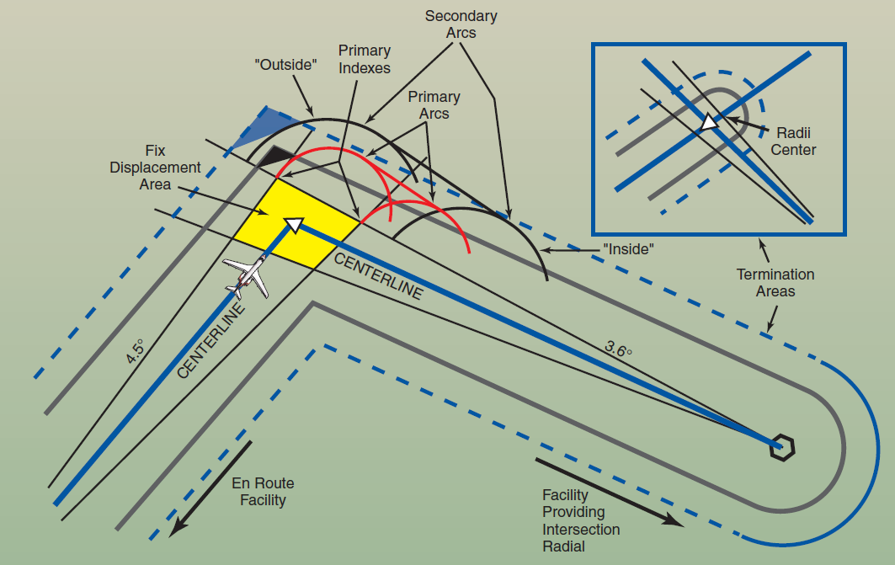

Slide 17
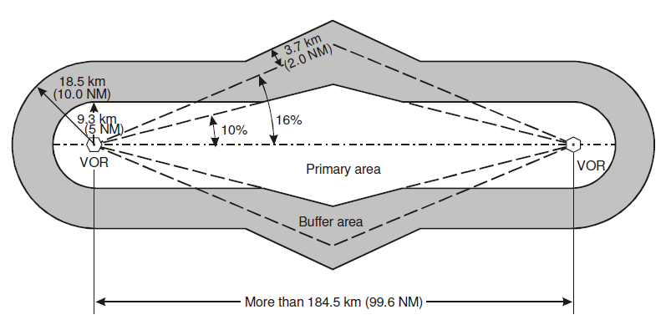
EN-ROUTE CRITERIA

Slide 18
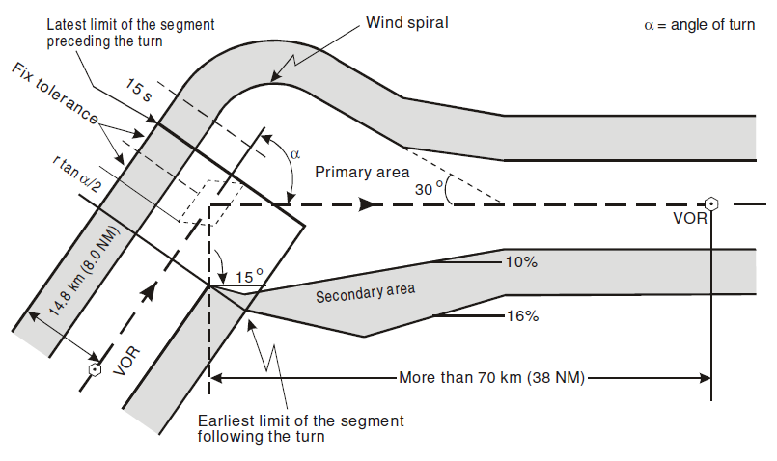
EN-ROUTE CRITERIA

Slide 19
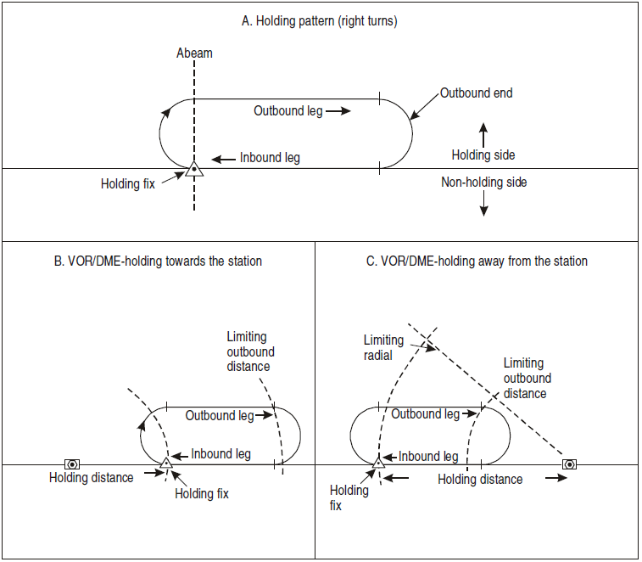

Slide 20
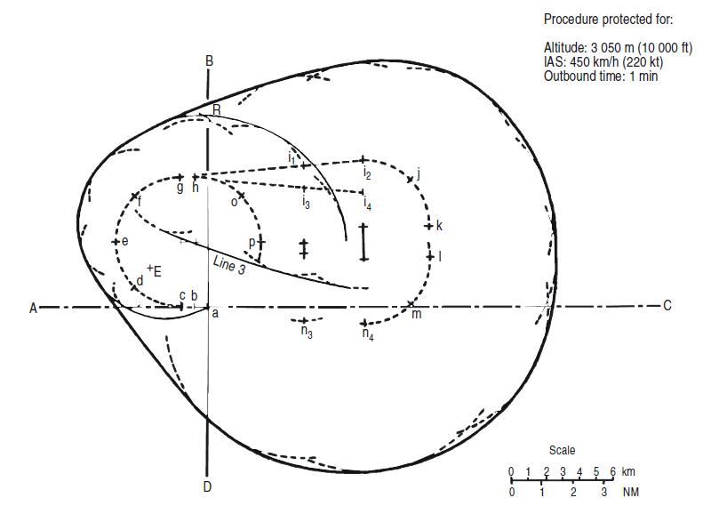
HOLDING- Protection Area

Slide 21
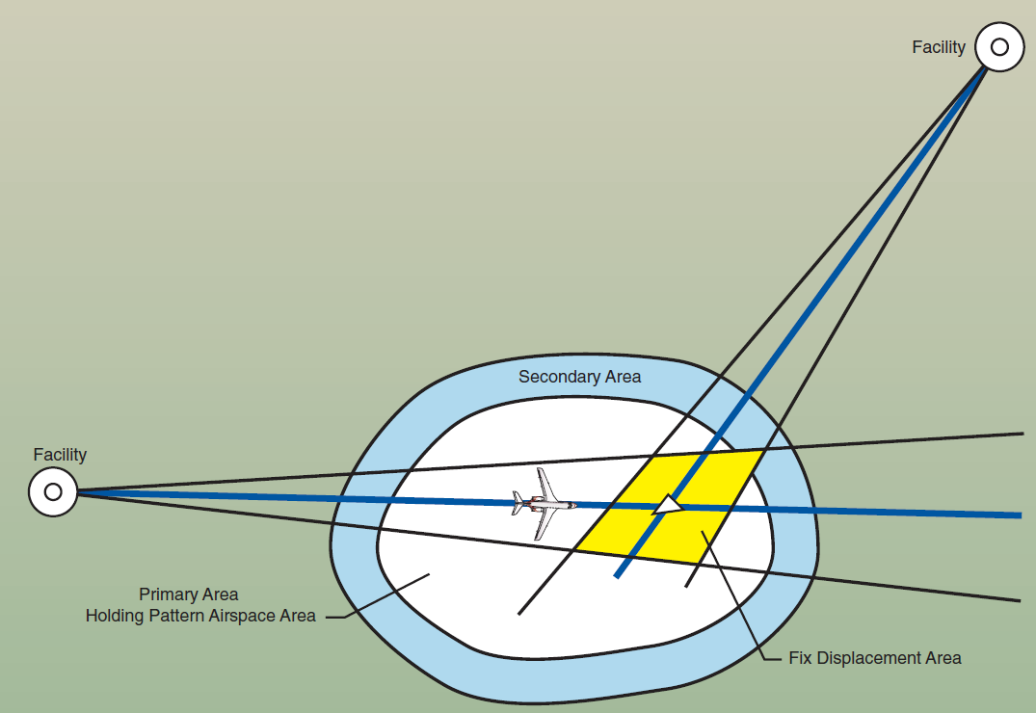
HOLDING- Protection Area

Slide 22
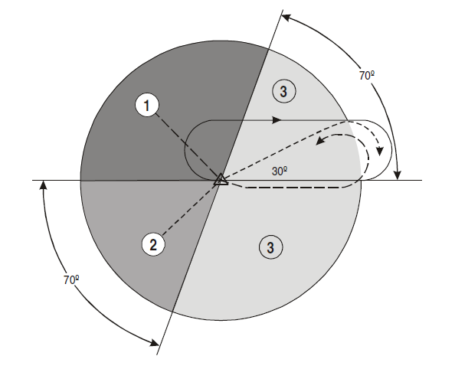
Holding Entry

Slide 23
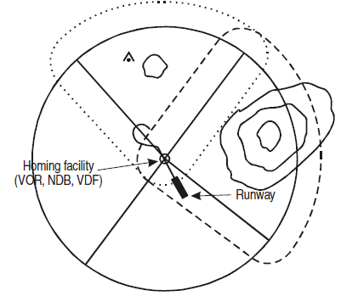
MINIMUM SECTOR ALTITUDES (MSA)

Slide 24
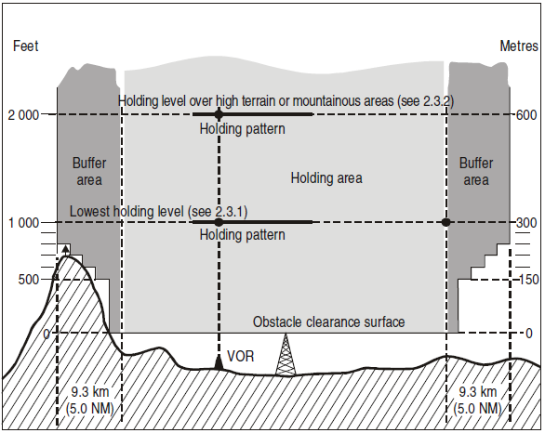
Minimum Holding Level

Slide 25
INSTRUMENT DEPARTURE PROCEDURE
The design of an instrument departure procedure is, in general, dictated by the terrain surrounding the aerodrome. It may also be required to provide for air traffic control (ATC) requirements in the case of SID routes. These factors in turn influence the type and siting of navigation aids in relation to the departure route. Airspace restrictions may also affect the routing and siting of navigation aids.
A departure procedure is established for each runway where instrument departures are expected to be used. It will include procedures for the various categories of aircraft.

Slide 26
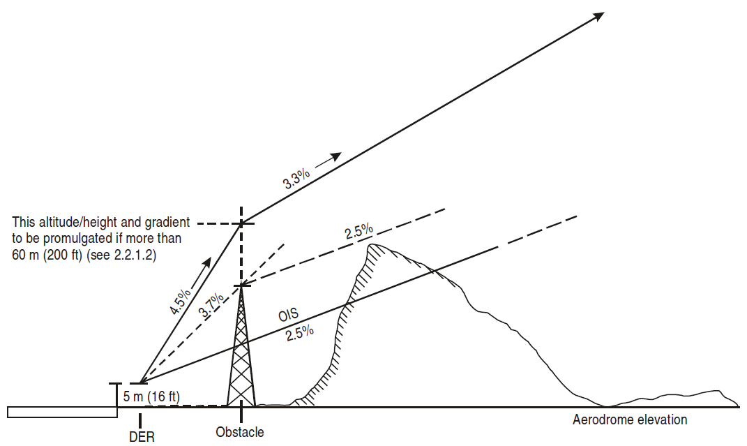
INSTRUMENT DEPARTURE PROCEDURE – Climb Gradient

Slide 27
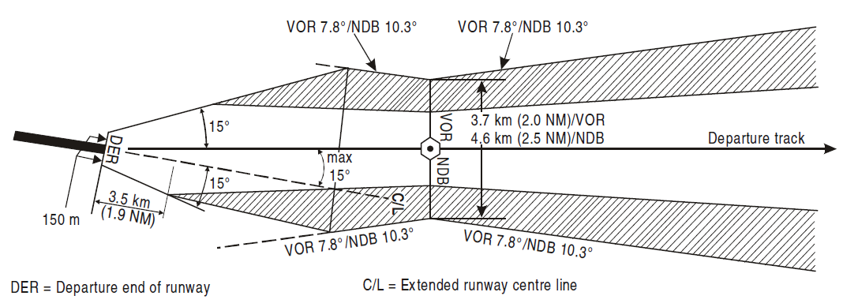
INSTRUMENT DEPARTURE PROCEDURE – Straight Path

Slide 28
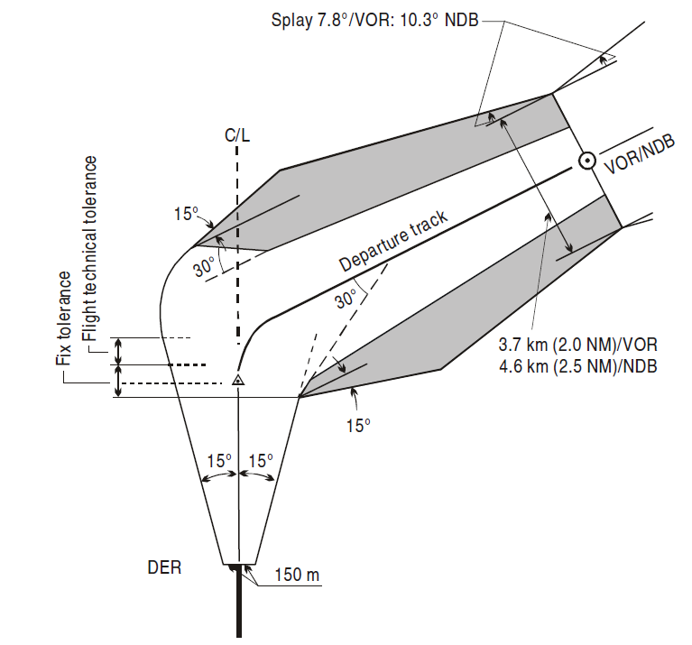
INSTRUMENT DEPARTURE PROCEDURE – Turn

Slide 29
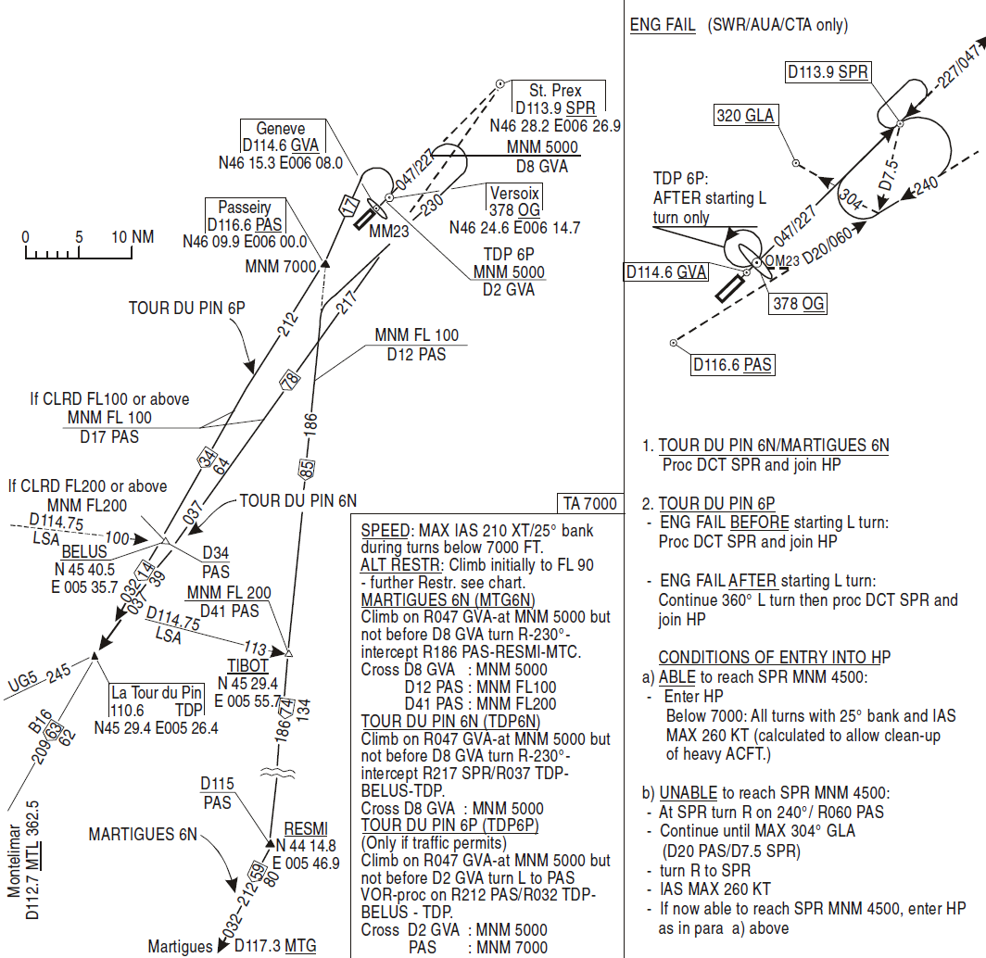
INSTRUMENT DEPARTURE PROCEDURE

Slide 30
Approach Procedure
The design of an instrument approach procedure is, in general, dictated by the terrain surrounding the aerodrome, the type of operations contemplated and the aircraft to be accommodated. These factors in turn influence the type and siting of navigation aids in relation to the runway or aerodrome. Airspace restrictions may also affect the siting of navigation aids.

Slide 31
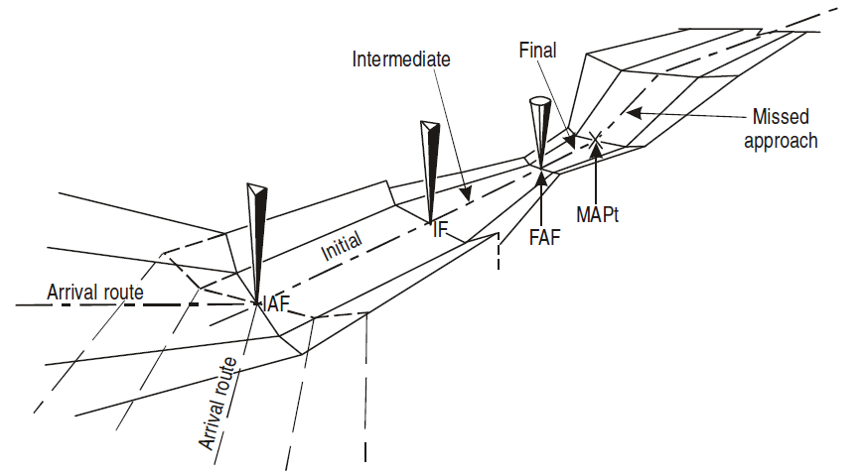
INSTRUMENT ARRIVAL PROCEDURE

Slide 32
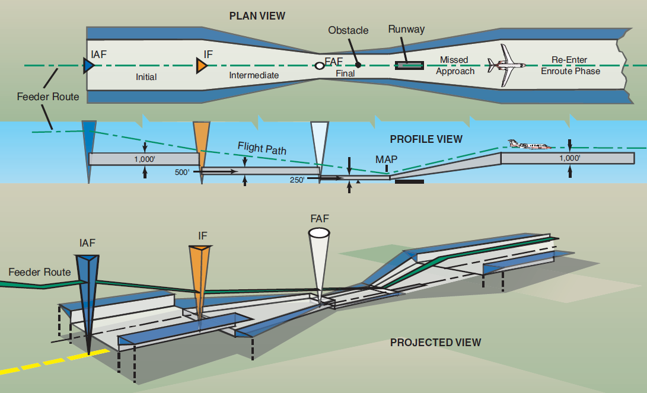
INSTRUMENT ARRIVAL PROCEDURE

Slide 33
Types of Approaches
Straight-in approach
Wherever possible, a straight-in approach will be specified which is aligned with the runway centre line. In the case of non-precision approaches, a straight-in approach is considered acceptable if the angle between the final approach track and the runway centre line is 30° or less.
Circling approach
A circling approach will be specified in those cases where terrain or other constraints cause the final approach track alignment or descent gradient to fall outside the criteria for a straight-in approach. The final approach track of a circling approach procedure is in most cases aligned to pass over some portion of the usable landing surface of the aerodrome.

Slide 34
CATEGORIES OF AIRCRAFT
Aircraft performance has a direct effect on the airspace and visibility required for the various maneuvers associated with the conduct of instrument approach procedures. The most significant performance factor is aircraft speed.
Accordingly, categories of typical aircraft have been established. These categories provide a standardized basis for relating aircraft maneuverability to specific instrument approach procedures. For precision approach procedures, the dimensions of the aircraft are also a factor for the calculation of the obstacle clearance height (OCH).
Category A: less than 169 km/h (91 kt) indicated airspeed (IAS)
Category B: 169 km/h (91 kt) or more but less than 224 km/h (121 kt) IAS
Category C: 224 km/h (121 kt) or more but less than 261 km/h (141 kt) IAS
Category D: 261 km/h (141 kt) or more but less than 307 km/h (166 kt) IAS
Category E: 307 km/h (166 kt) or more but less than 391 km/h (211 kt) IAS
Category H: “Helicopters”.

Slide 35
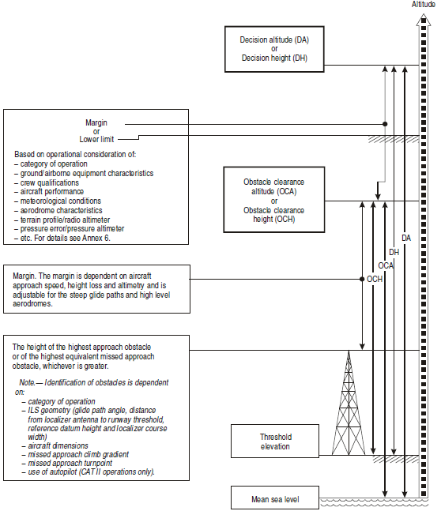
Precision Approach and Decision Altitude

Slide 36
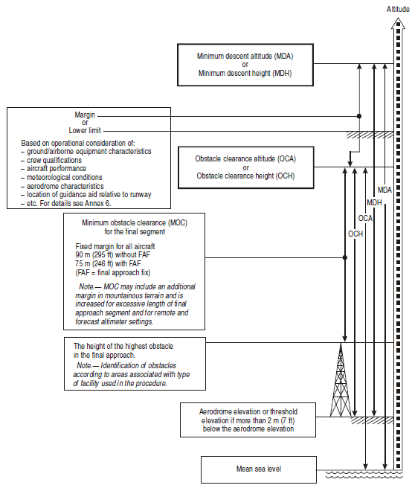
Non-Precision Approach and Minimum Descent Altitude

Slide 37
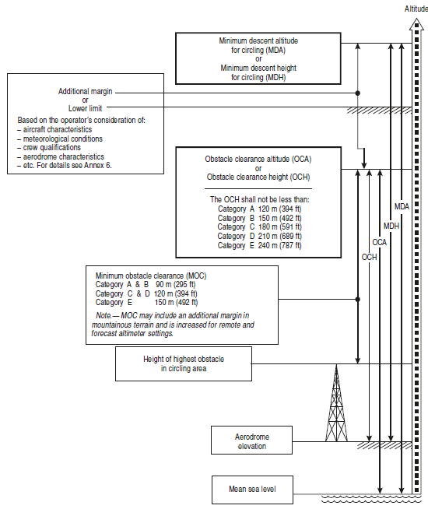
Visual Maneuvering and Minimum Descent Altitude

Slide 38
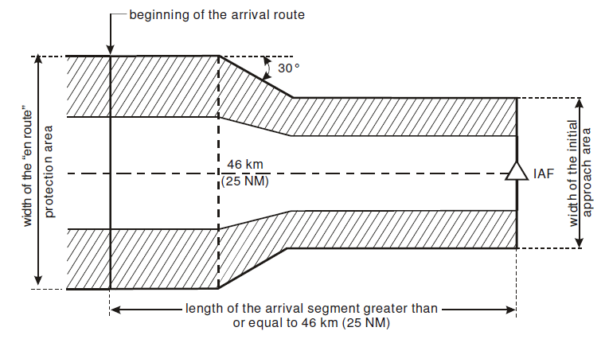
Arrival Segment

Slide 39
INITIAL APPROACH SEGMENT
Maximum angle of interception of initial approach segment
Normally track guidance is provided along the initial approach segment to the IF, with a maximum angle of interception of:
a) 90° for a precision approach; and
b) 120° for a non-precision approach.
Minimum obstacle clearance
The initial approach segment provides at least 300 m (1 000 ft) of obstacle clearance in the primary area, reducing laterally to zero at the outer edge of the secondary area.

Slide 40
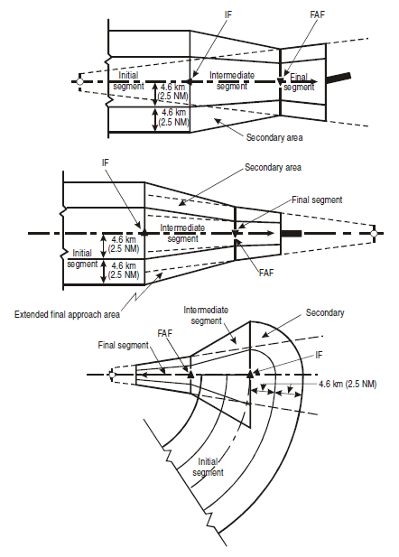
INITIAL APPROACH SEGMENT

Slide 41
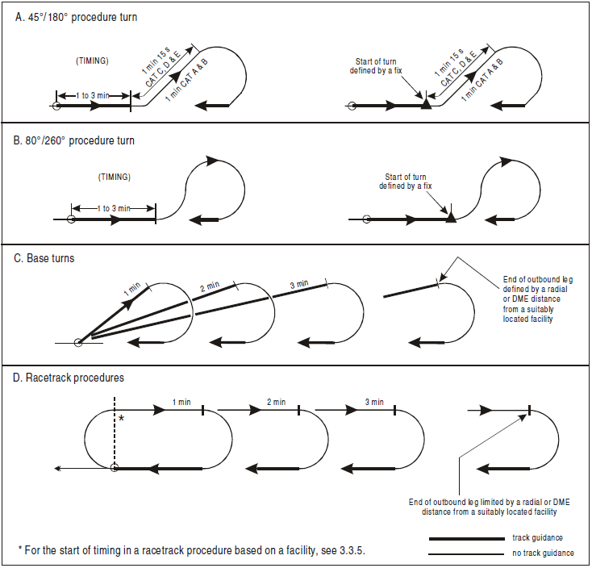
TYPES OF Reversal Procedures

Slide 42
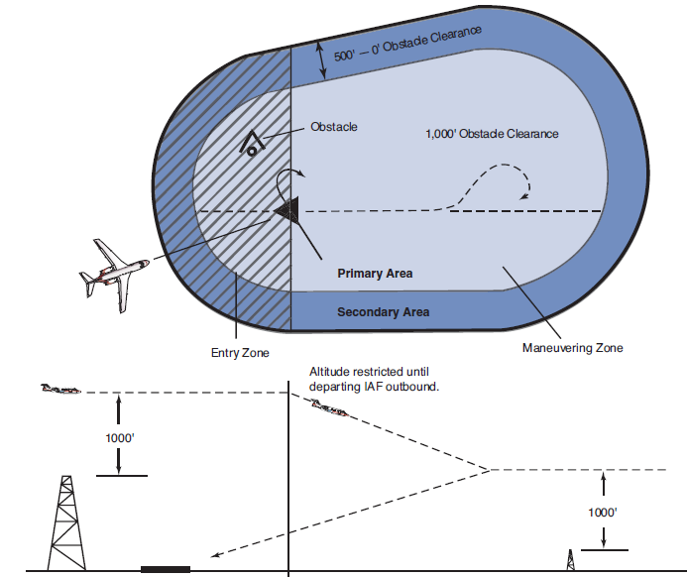

Slide 43
INTERMEDIATE APPROACH SEGMENT
Minimum obstacle clearance
During the intermediate approach, the obstacle clearance requirement reduces from 300 m (984 ft) to 150 m (492 ft) in the primary area, reducing laterally to zero at the outer edge of the secondary area.
Beginning and end of the segment
Where a final approach fix (FAF) is available, the intermediate approach segment begins when the aircraft is on the inbound track of the procedure turn, base turn or final inbound leg of the racetrack procedure. It ends at the FAF or final approach point (FAP), as applicable.

Slide 44
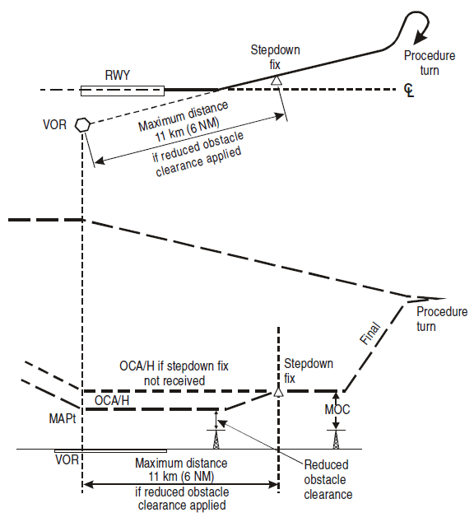
FINAL APPROACH SEGMENT-Step-down

Slide 45
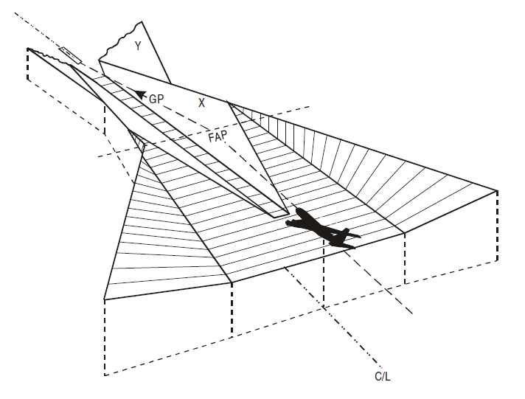
FINAL APPROACH SEGMENT

Slide 46
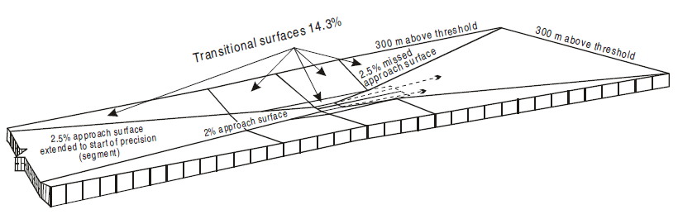
FINAL APPROACH SEGMENT

Slide 47
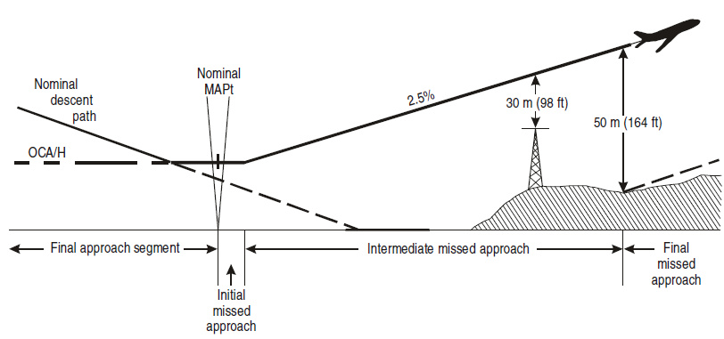
MISSED APPROACH SEGMENT

Slide 48
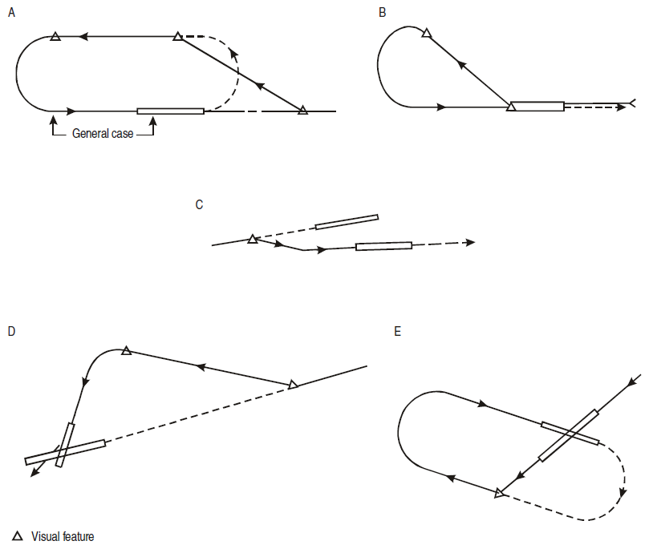
VISUAL MANOEUVRING (CIRCLING) AREA

Slide 49
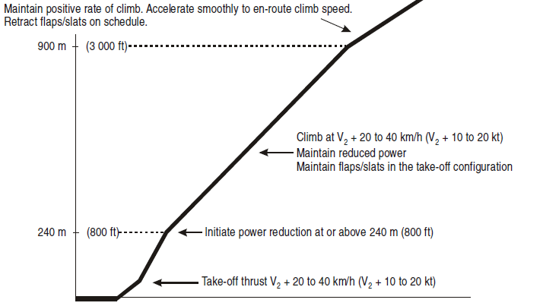
Noise Abatement Procedures

Slide 50
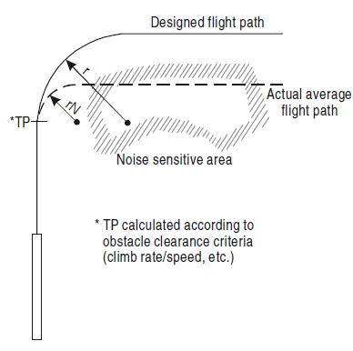
Noise Abatement Procedures

Slide 51
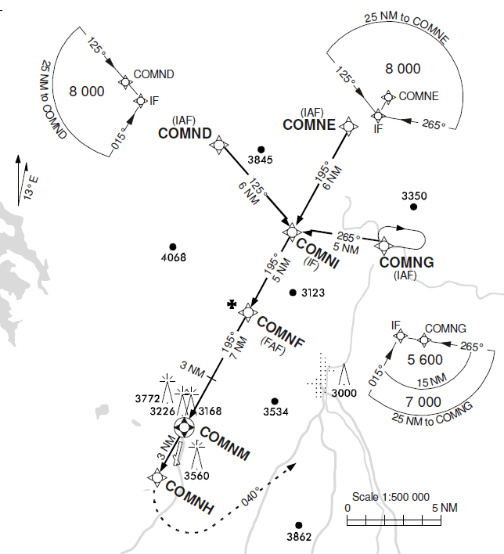
FLIGHT PROCEDURES — RNAV AND SATELLITE-BASED

Slide 52
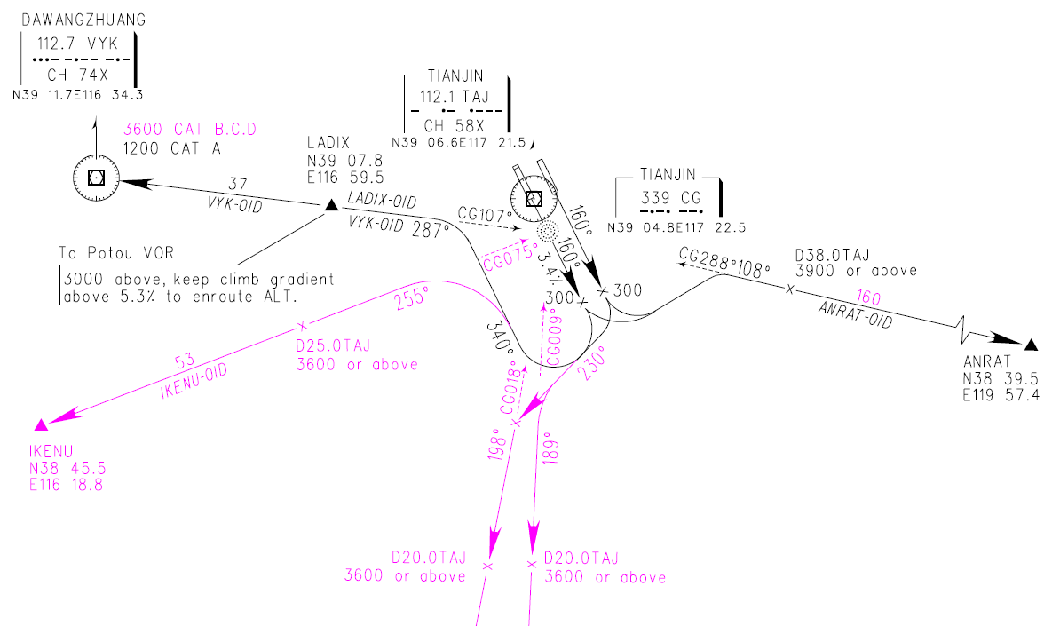
Flight Procedure Examples - Tianjin
Standard Departure Route/Runway 16L &16R

Slide 53
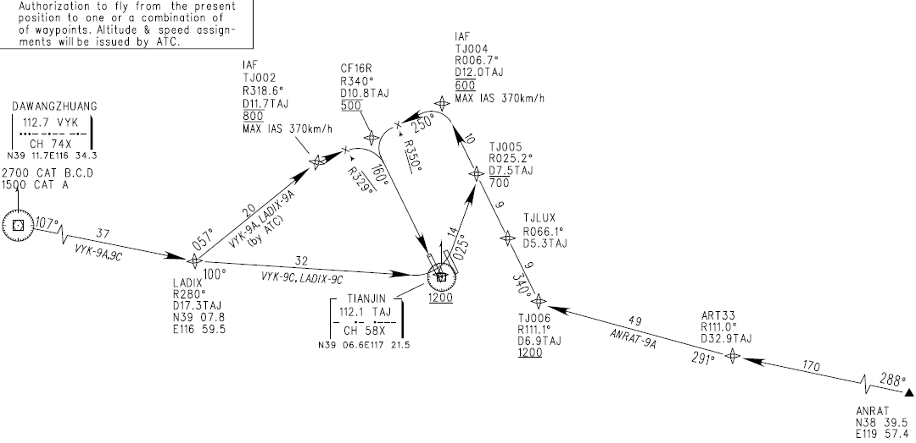
Flight Procedure Examples - Tianjin
Standard Arrival Route/RNAV Runway 16R

Slide 54
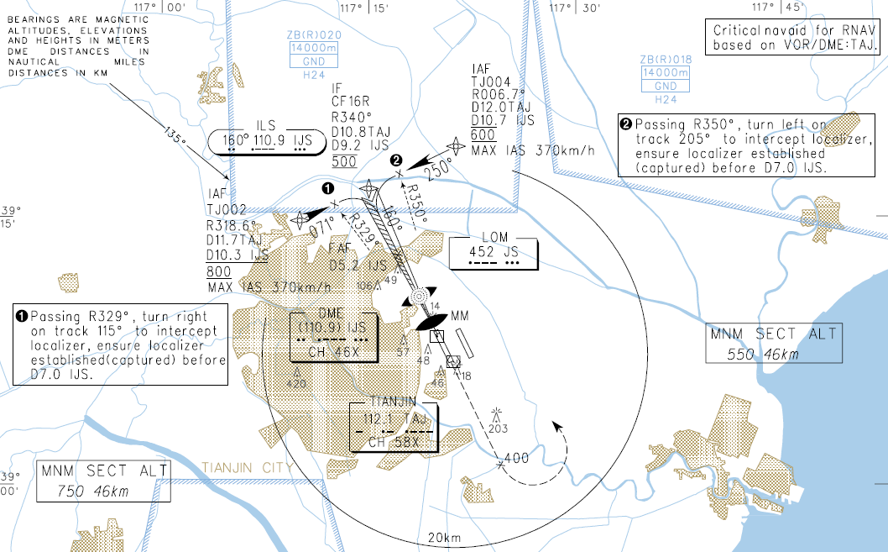
Flight Procedure Examples - Tianjin
Approach /RNAV ILS Runway 16R/Plan view

Slide 55
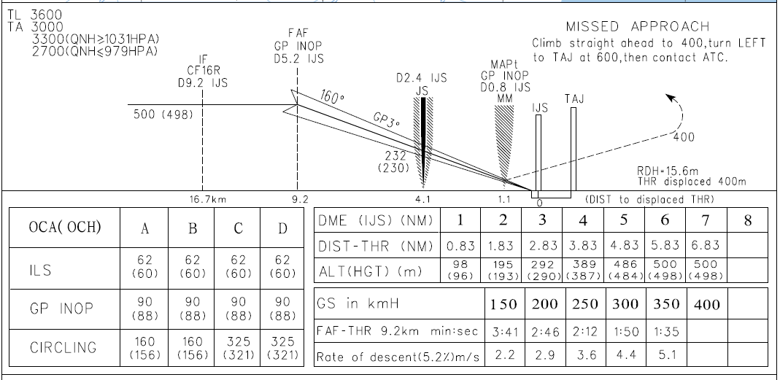
Flight Procedure Examples - Tianjin
Approach /RNAV ILS Runway 16R/Vertical View

Slide 56
Questions
What are the accuracies of NDB, VOR and ILS?
What are factors to be considered in the design of flight procedures?
What are the five categories of aircraft speed?
What are the five segments of an approach procedure?
What is the difference between a precision approach and a non-precision approach?
How is Decision Altitude determined?
What are the different types of reversal procedures?
What are the elements that defines a holding pattern?
What is the use of Minimum Sector Altitude?
Describe the arrival route to Tianjin Binhai airport runway 16R.
Describe the approach procedure to Tianjin Binhai airport runway 16R.

